Slide 1
Energy Consumption
Guide by : - Ms. Arpita Roy
Project by :- Susma Kumari Singh
(The Data Detectives)

Slide 2
Content
Problem Statement
Project Overview
Why need this ?
How Energy consumption will help people ?
How can energy consumption help individuals save money ?
Solution
Demo-analysis
Modelling

Slide 3
Problem Statement
Design a system or implement a strategy to optimize energy consumption in a specific domain, such as residential, industrial, or transportation, with the aim of reducing energy waste, lowering costs, and minimizing the environmental impact.
This should include data collection, analysis, and the development of efficient technologies or practices to achieve the desired energy consumption reduction goals.

Slide 4
Project Overview
The Energy Consumption Optimization Project seeks to address the challenges of high energy usage by implementing data-driven strategies and innovative technologies to reduce energy consumption while maintaining or improving overall performance and comfort.
This project is focused on (specify the context or sector, e.g., residential, industrial, commercial) energy consumption.
So I started in IBM Cloud machine learning. IN IBM Cloud also we implement Jupyter by using Watson Studio we take our dataset file(csv).

Slide 5
Why need this ?
High energy consumption is often associated with increased carbon emissions and other pollutants, contributing to climate change and environmental degradation.
By reducing energy consumption, we can mitigate these adverse effects and work towards a more sustainable planet.

Slide 6
How Energy consumption will help people ?
Reduced energy consumption leads to lower utility bills, making it more affordable for people to heat, cool, and power their homes.
This is particularly important for low-income households, as it eases financial burdens and improves energy affordability.

Slide 7
How can energy consumption help individuals save money ?
Monitoring energy consumption can identify areas for improvement, such as upgrading appliances or insulating homes, leading to lower energy bills.

Slide 8
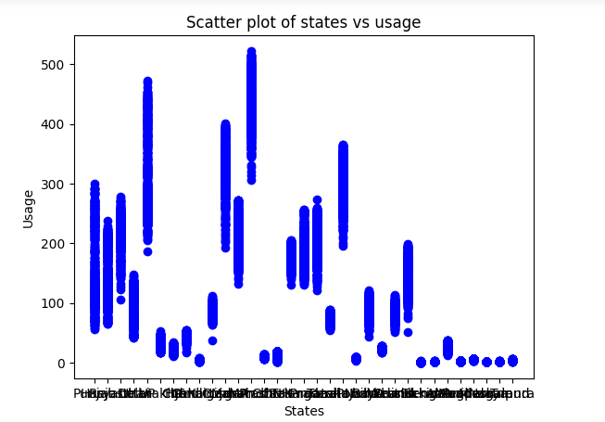
Solution
Through the chart, we will be able to see how much electricity is being used at which place so that the government can use some modern equipment at that place so that electricity consumption is reduced day by day.

Slide 9
Demo-analysis
https://github.com/Susmaksingh/-Energy_consumption
or
https://susmaksingh.github.io/-Energy_consumption/

Slide 10
Modelling
Collecting Data
Building the model
Analyzing
Data input & Calculations
Output

Slide 11
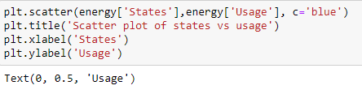
Result
The code creates a scatter plot of energy consumption data, showing the relationship between states and energy usage in blue.

Slide 12
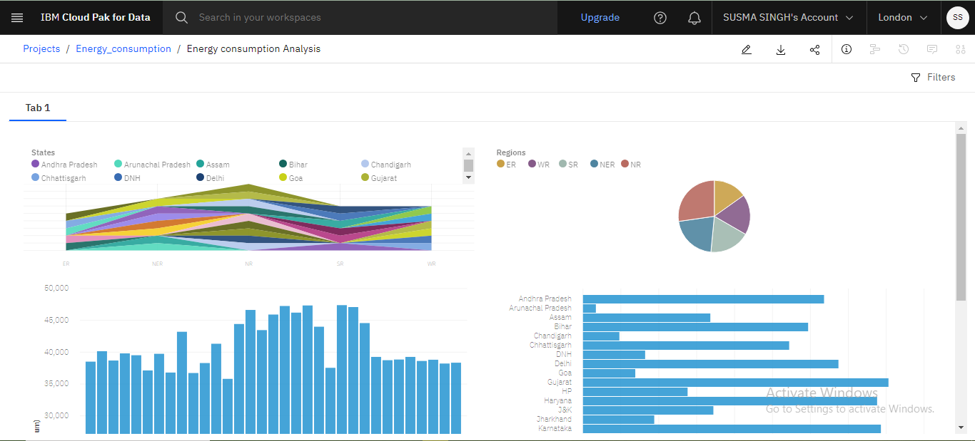
Result

Slide 13

Thank You

